Slide 1
CASA0005: Geographic Information Systems and Science
Dr Andy MacLachlan and Prof Adam Dennett
Valentina Marin Maureira, Laura Sheppard, Olly Dawkins
Centre for Advanced Spatial Analysis
Please go to: https://vevox.app/ or download the Vevox app on your smartphone / laptop
Use ID: 186-395-009

Slide 2
Welcome!!

Slide 3
We’re online so please turn off all distractions you have on your computer / tablet / phone…

Slide 4
Before we go over the module intro stuff…If someone gives you some data, what is the first thing you do aside from loading?

Slide 5
What is the first thing you do with data?
Join: vevox.app ID: 186-395-009
Enter Text and Press Send
Vote Trigger

Slide 6
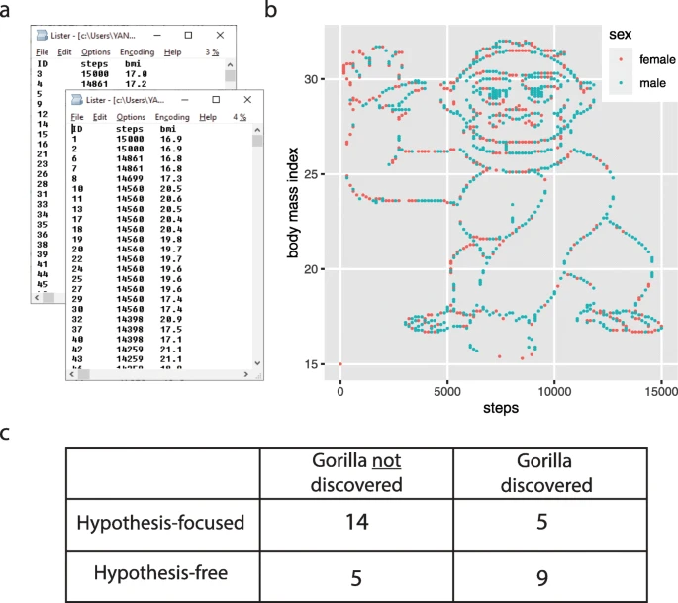
Plot it….
“The most notable “discovery” in the dataset was that if you simply plotted the number of steps versus the BMI, you would see an image of a gorilla waving at you (Fig. 1b). While we teach our students the benefits of visualization, answering the specific hypothesis-driven questions did not require plotting the data. We found that very often, the students driven by specific hypotheses skipped this simple step towards a broader exploration of the data. In fact, overall, students without a specific hypothesis were almost five times more likely to discover the gorilla when analyzing this dataset”
Yanai and Lercher (2020)

Slide 7


Housekeeping…
Please ask questions on slack in the #gis channel.
Everyone can see slack questions after the session and add responses / further questions and discussion
Ask anonymous questions: https://casa-students-2021.slack.com/apps/ATMC26LBW-anonymous-bot?tab=more_info

Slide 8
Expectations…
The teaching team expects:
You to engage with the lectures, workshops and other students
Challenge yourself
Ask questions
Complete the tasks we give you
Listen to our feedback
Understand that we know a lot (?) but not everything…but we will likely know where to look

Slide 9
Expectations…
The students can expect:
Staff to be present and available for questions at the sessions
To be taught current and modern geospatial methodologies and approaches applicable to MSc level of study
To have opportunity to go beyond the core materials
To be challenged

Slide 10
You said … we did…
Summary of responses from surverys:
It’s hard to learn R
More code or workshop explanations / walk throughs
GIS buddies idea was good
Opportunities to test your knowledge
Practical class are pretty hard to keep up
More optional practices to understand the GIS conception

Slide 11
Housekeeping…
Sessions:
1hr Lecture – Tuesdays 2-3pm
Practical – Wednesdays 1-4pm
1 – 2:30pm Andy will go through the material
2 - 4pm PGTA and Andy will take questions
Drop in sessions – Fridays 10-12pm OR 12-2pm, Taviton (16) 347, holds 65
Online and in person, capped at 35 per room
Will discuss weekly tasks
Take questions
Later in the term there are additional PGTA seminar sessions
Everything is recorded

Slide 12

Housekeeping
No lecture & practical in reading week…
Format – 1 hour lecture, 2 hour ‘core’ practical session the next day + work in your own time + drop in sessions + some seminars
15 Credit module ~ 150 hours of work
Assessment: open book exam on 17th December 2021 9am-3pm
You will have to select one question (from a choice) and complete the task, following the instructions
There will be practice exam questions around reading week
Set homework tasks will help…do them!

Slide 13


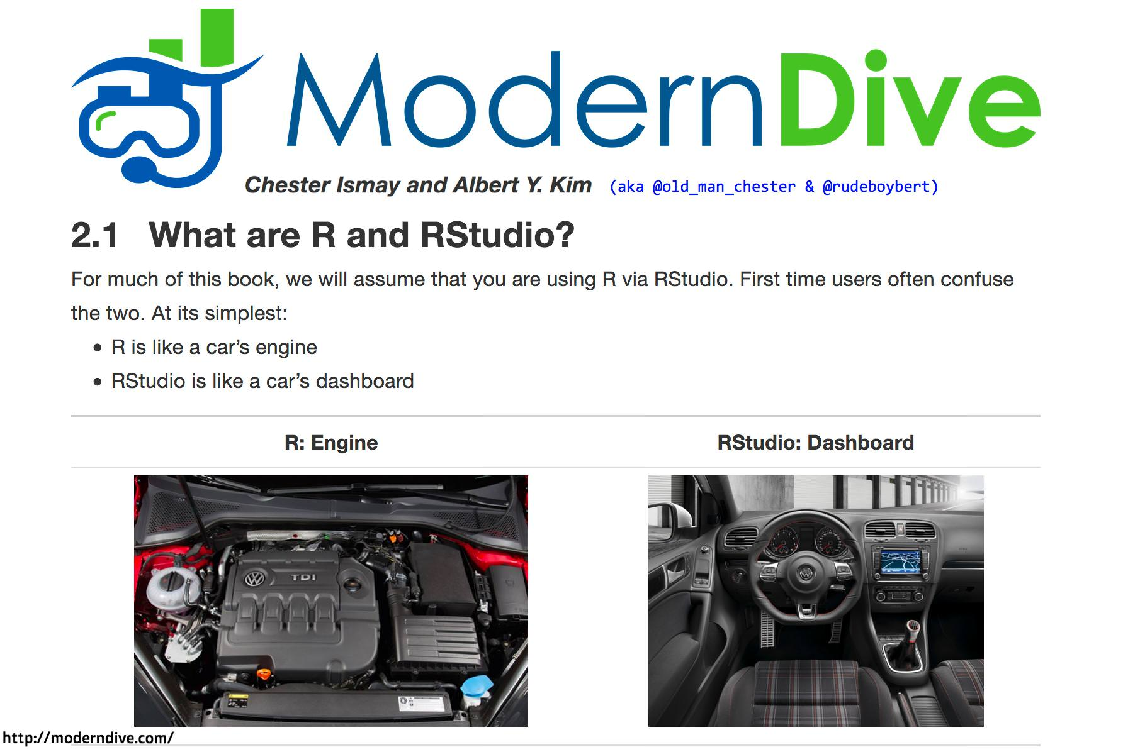
Software for the Course
R (& R Studio)
Available for free from the web
http://www.r-project.org/
http://www.rstudio.com/

Slide 14
Software for the Course
QGIS
Free and Open Source GIS which works on ANY computer operating system with free ‘Plugins’
http://www.qgis.org/

Slide 15
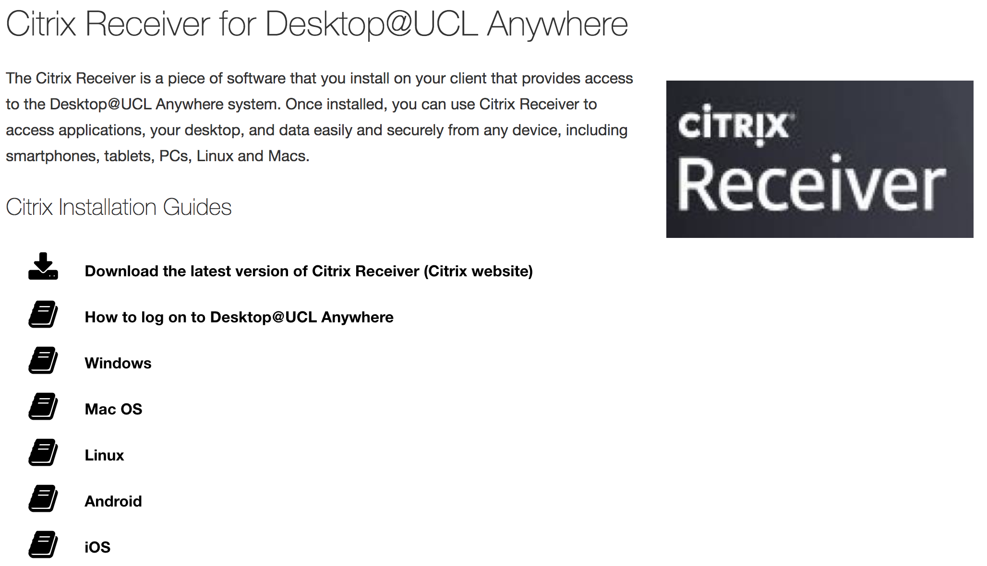
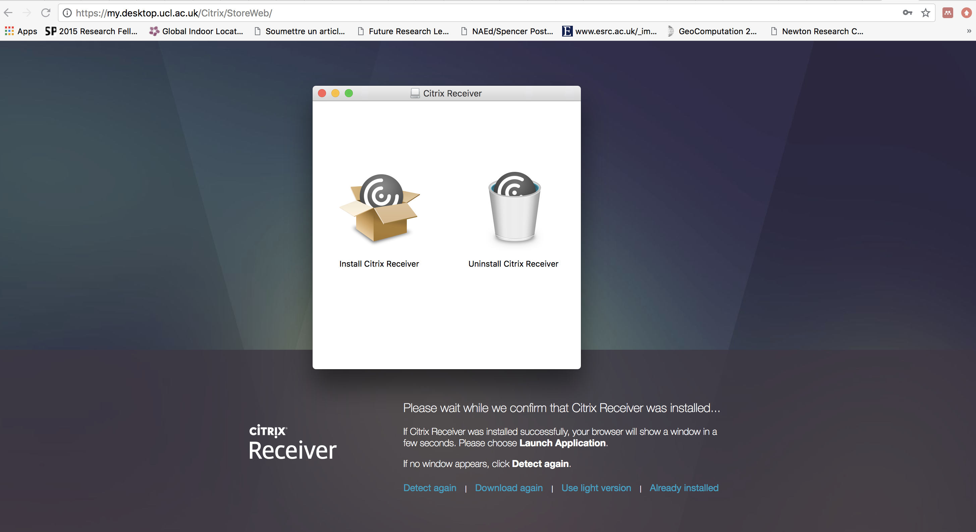

Remote Desktop
For instructions and help:
https://www.ucl.ac.uk/isd/services/computers/remote-access/desktopucl-anywhere/desktopucl-anywhere-how-to-guides

Slide 16
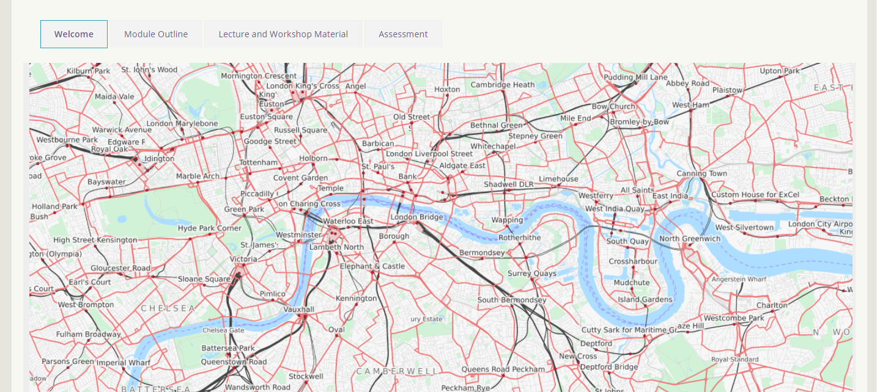
Moodle

Slide 17
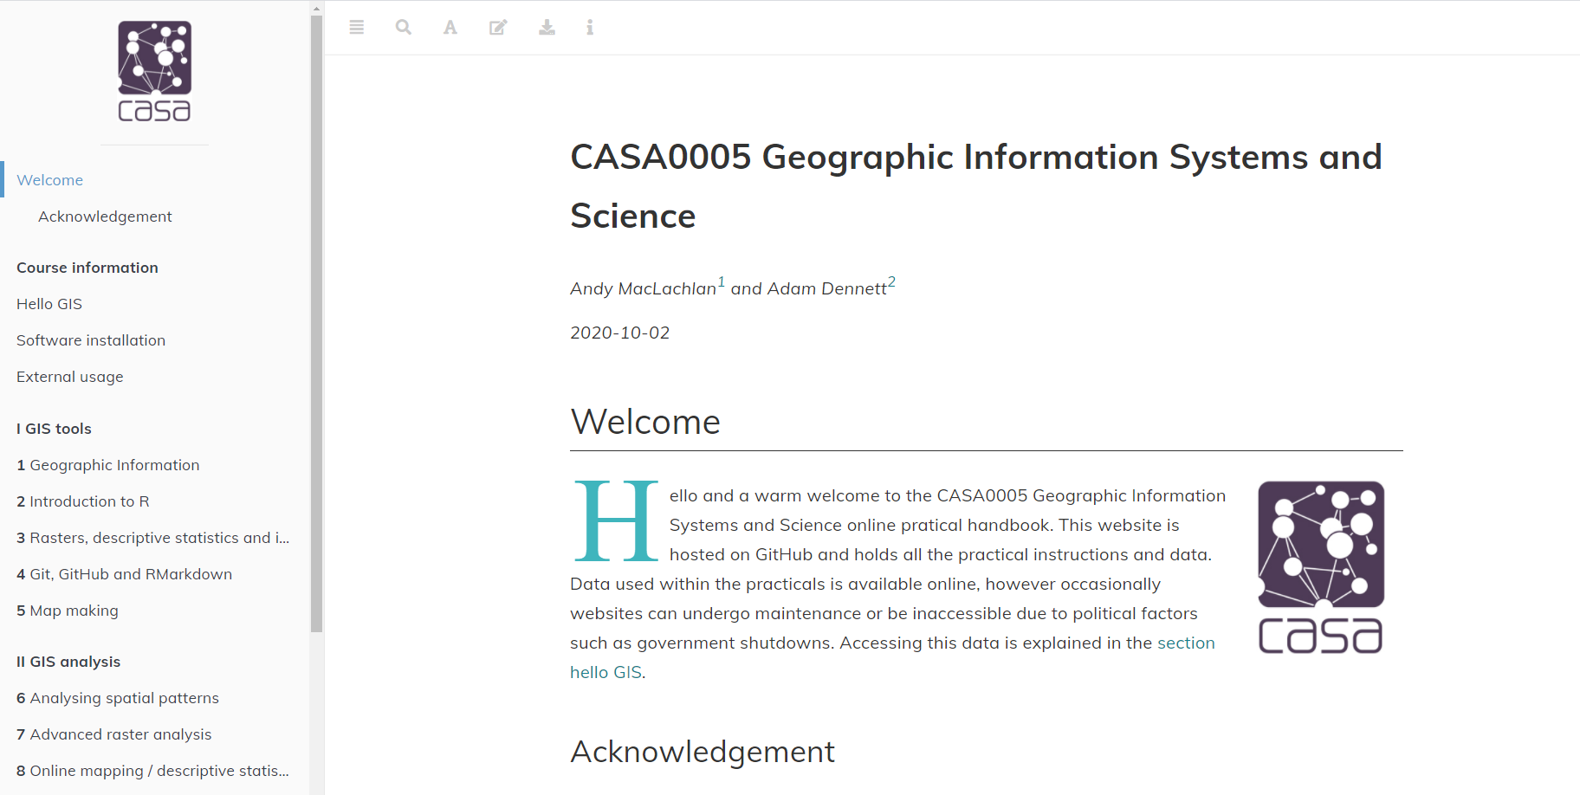
Practical Book run through
Practical book: https://andrewmaclachlan.github.io/CASA0005repo/
Code that ‘powers’ it / nearly all of the data used in the course: https://github.com/andrewmaclachlan/CASA0005repo

Slide 18
Practical Book run through
Don’t worry about using Git / GitHub or what they are we cover it in the course. Just follow the instructions and think.
Practical book: https://andrewmaclachlan.github.io/CASA0005repo/
Code that ‘powers’ it / nearly all of the data used in the course: https://github.com/andrewmaclachlan/CASA0005repo

Slide 19

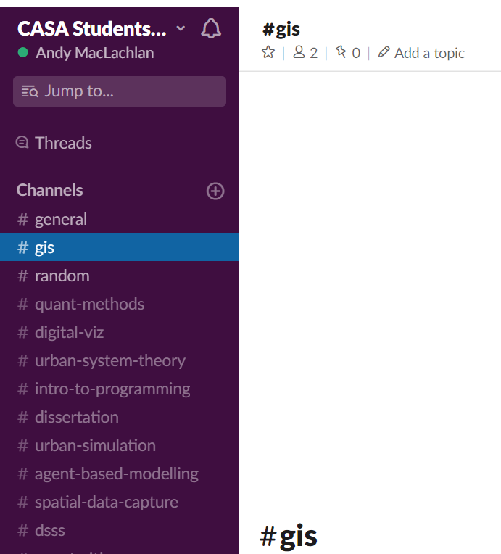
Help and Communication
Sign up via the link on Moodle (all UCL email addresses should be valid)
Any questions, problems, issues etc. post on here

Slide 20


Communication
= Questions that you want answered by the teaching team for the module or questions that you want to discuss with each other knowing the staff can help #GIS channel. Access the link on Moodle
= Personal / administration issues only. If you ask a question about module or assignment content expect “please ask this question on slack” between 1 and 5 days later.

Slide 21
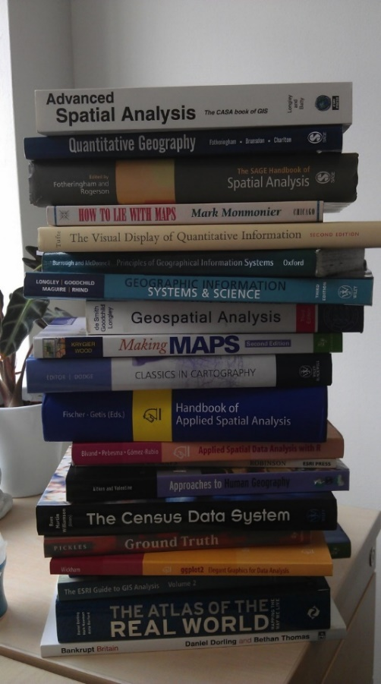
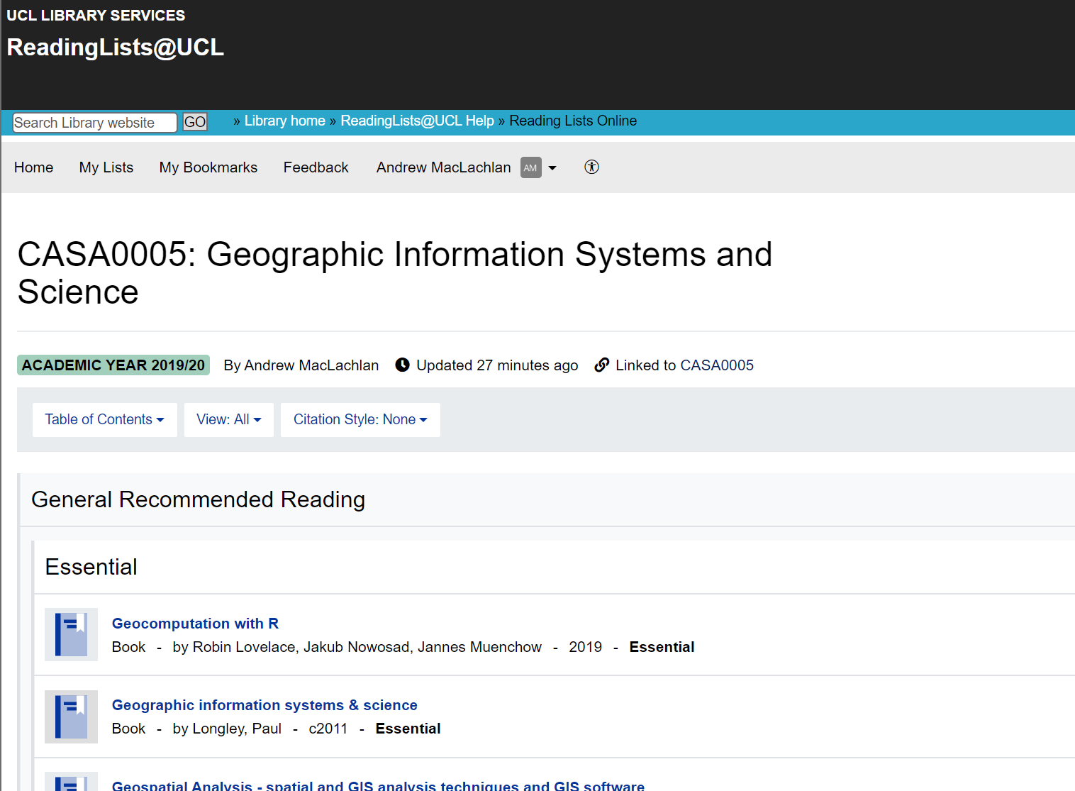
Reading List
Link to from Moodle / practical book
Reading for each week

Slide 22
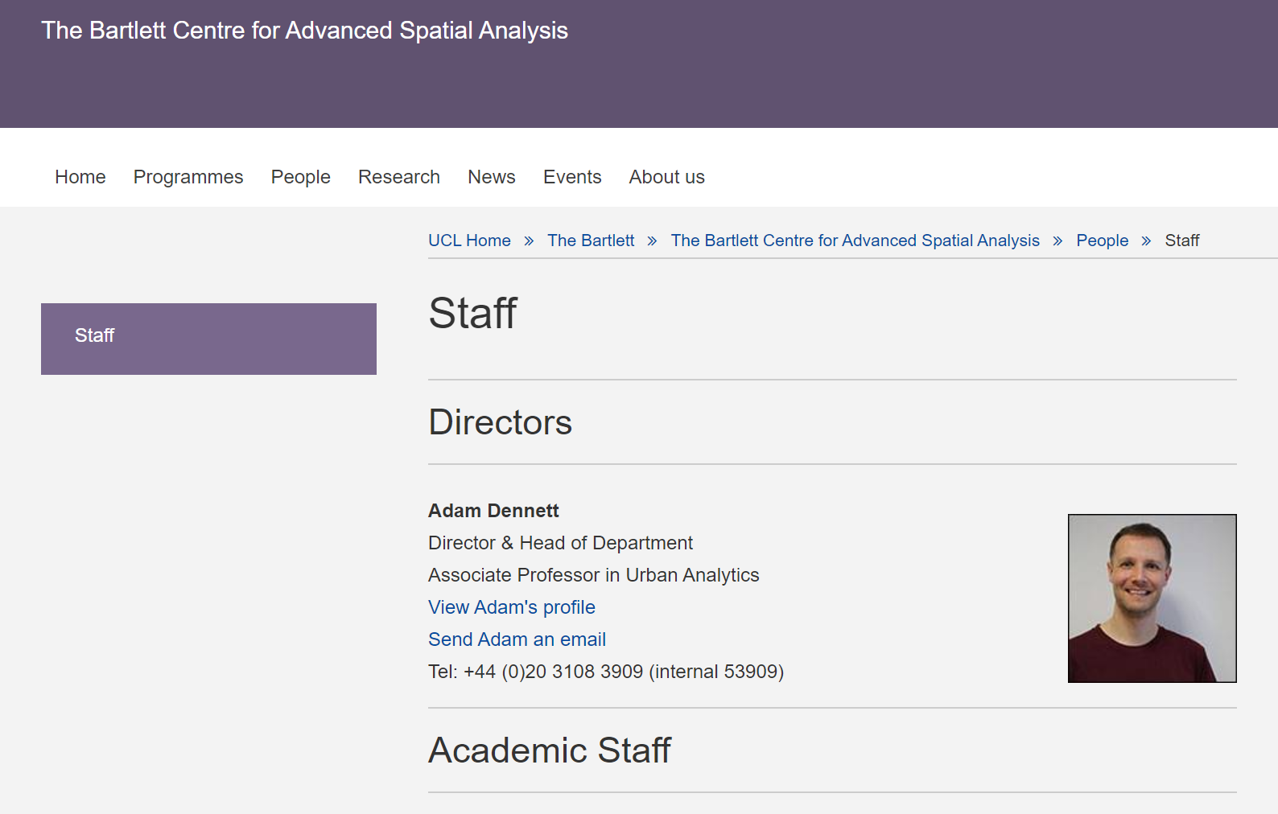
Staff
Andy, module convenor and SCUA lead @andymaclachlan
Adam Dennett (Head of department) @adam_dennett
Postgraduate Teaching Assistants: Valentina, Laura, Olly
Ask us questions and don’t be afraid to make mistakes now and not in the assessments.

Slide 23
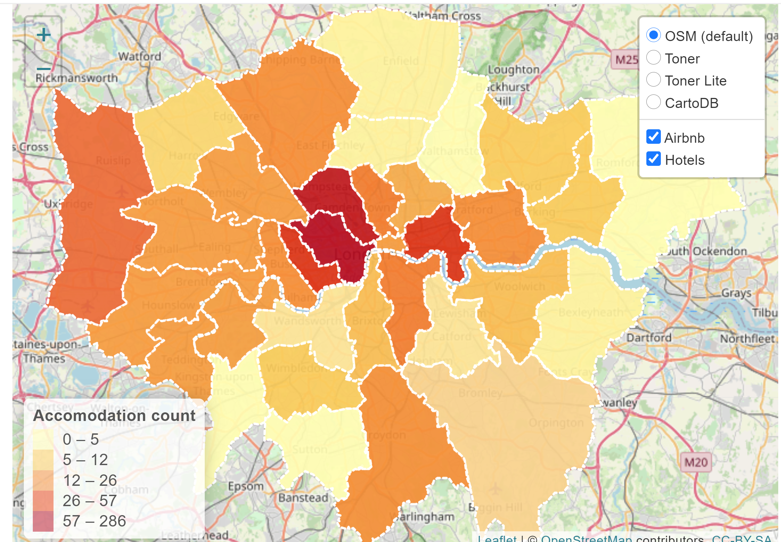
What will I learn in this course?
How to make cool interactive maps / good and bad cartography practices

Slide 24






What will I learn in this course?
All about spatial data…
Where we can get it
How it’s stored, principal formats etc.

Slide 25
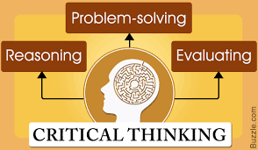
What will I learn in this course?
How to be a good Geographic Information / Spatial Data Scientist
By being aware of problems in the definition, measurement and accuracy of spatial data and how these might affect our analyses
By being practiced in the process of converting raw data into information to solve spatial problems…
…through becoming familiar with a variety of spatial analysis techniques and how to apply them…
And by being self-critical throughout

Slide 26

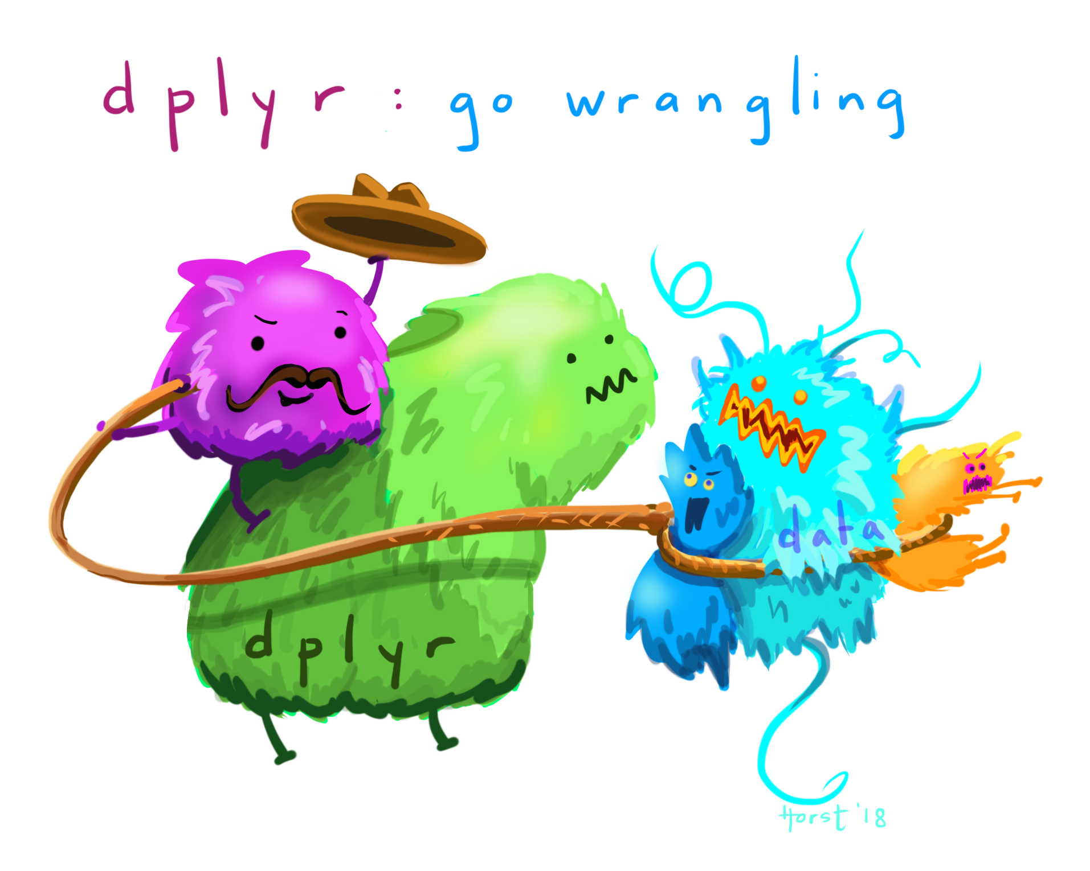
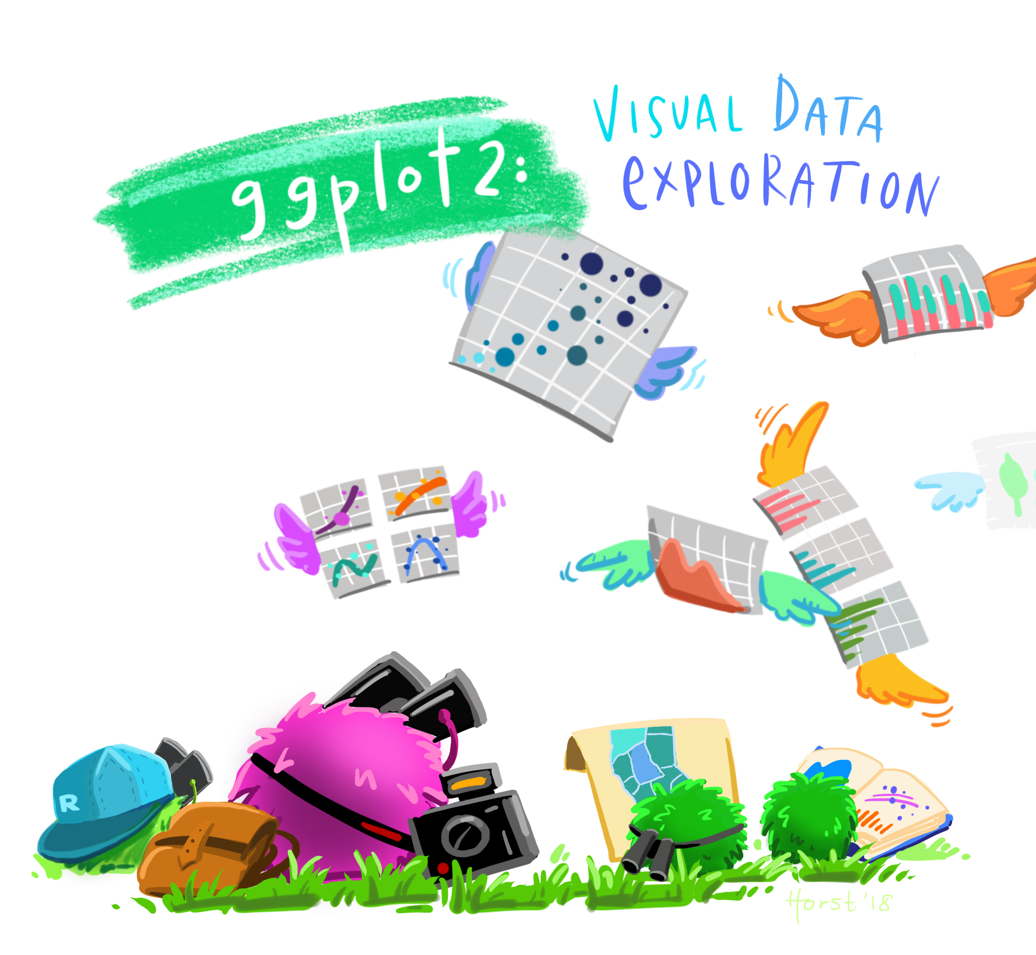
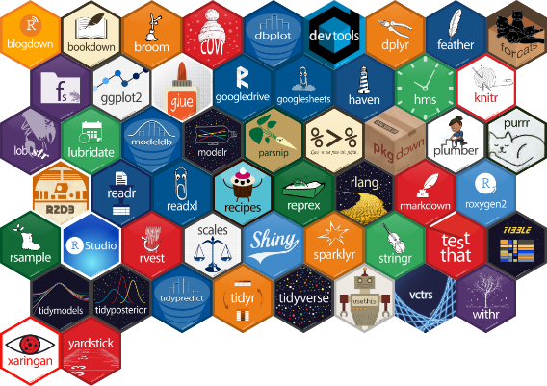
What will I learn in this course?
Practical / transferable skills – how to program in R and use QGIS software. Images from Allison horst
The grammar of:
Graphics
Data manipulation
%>% means then

Slide 27
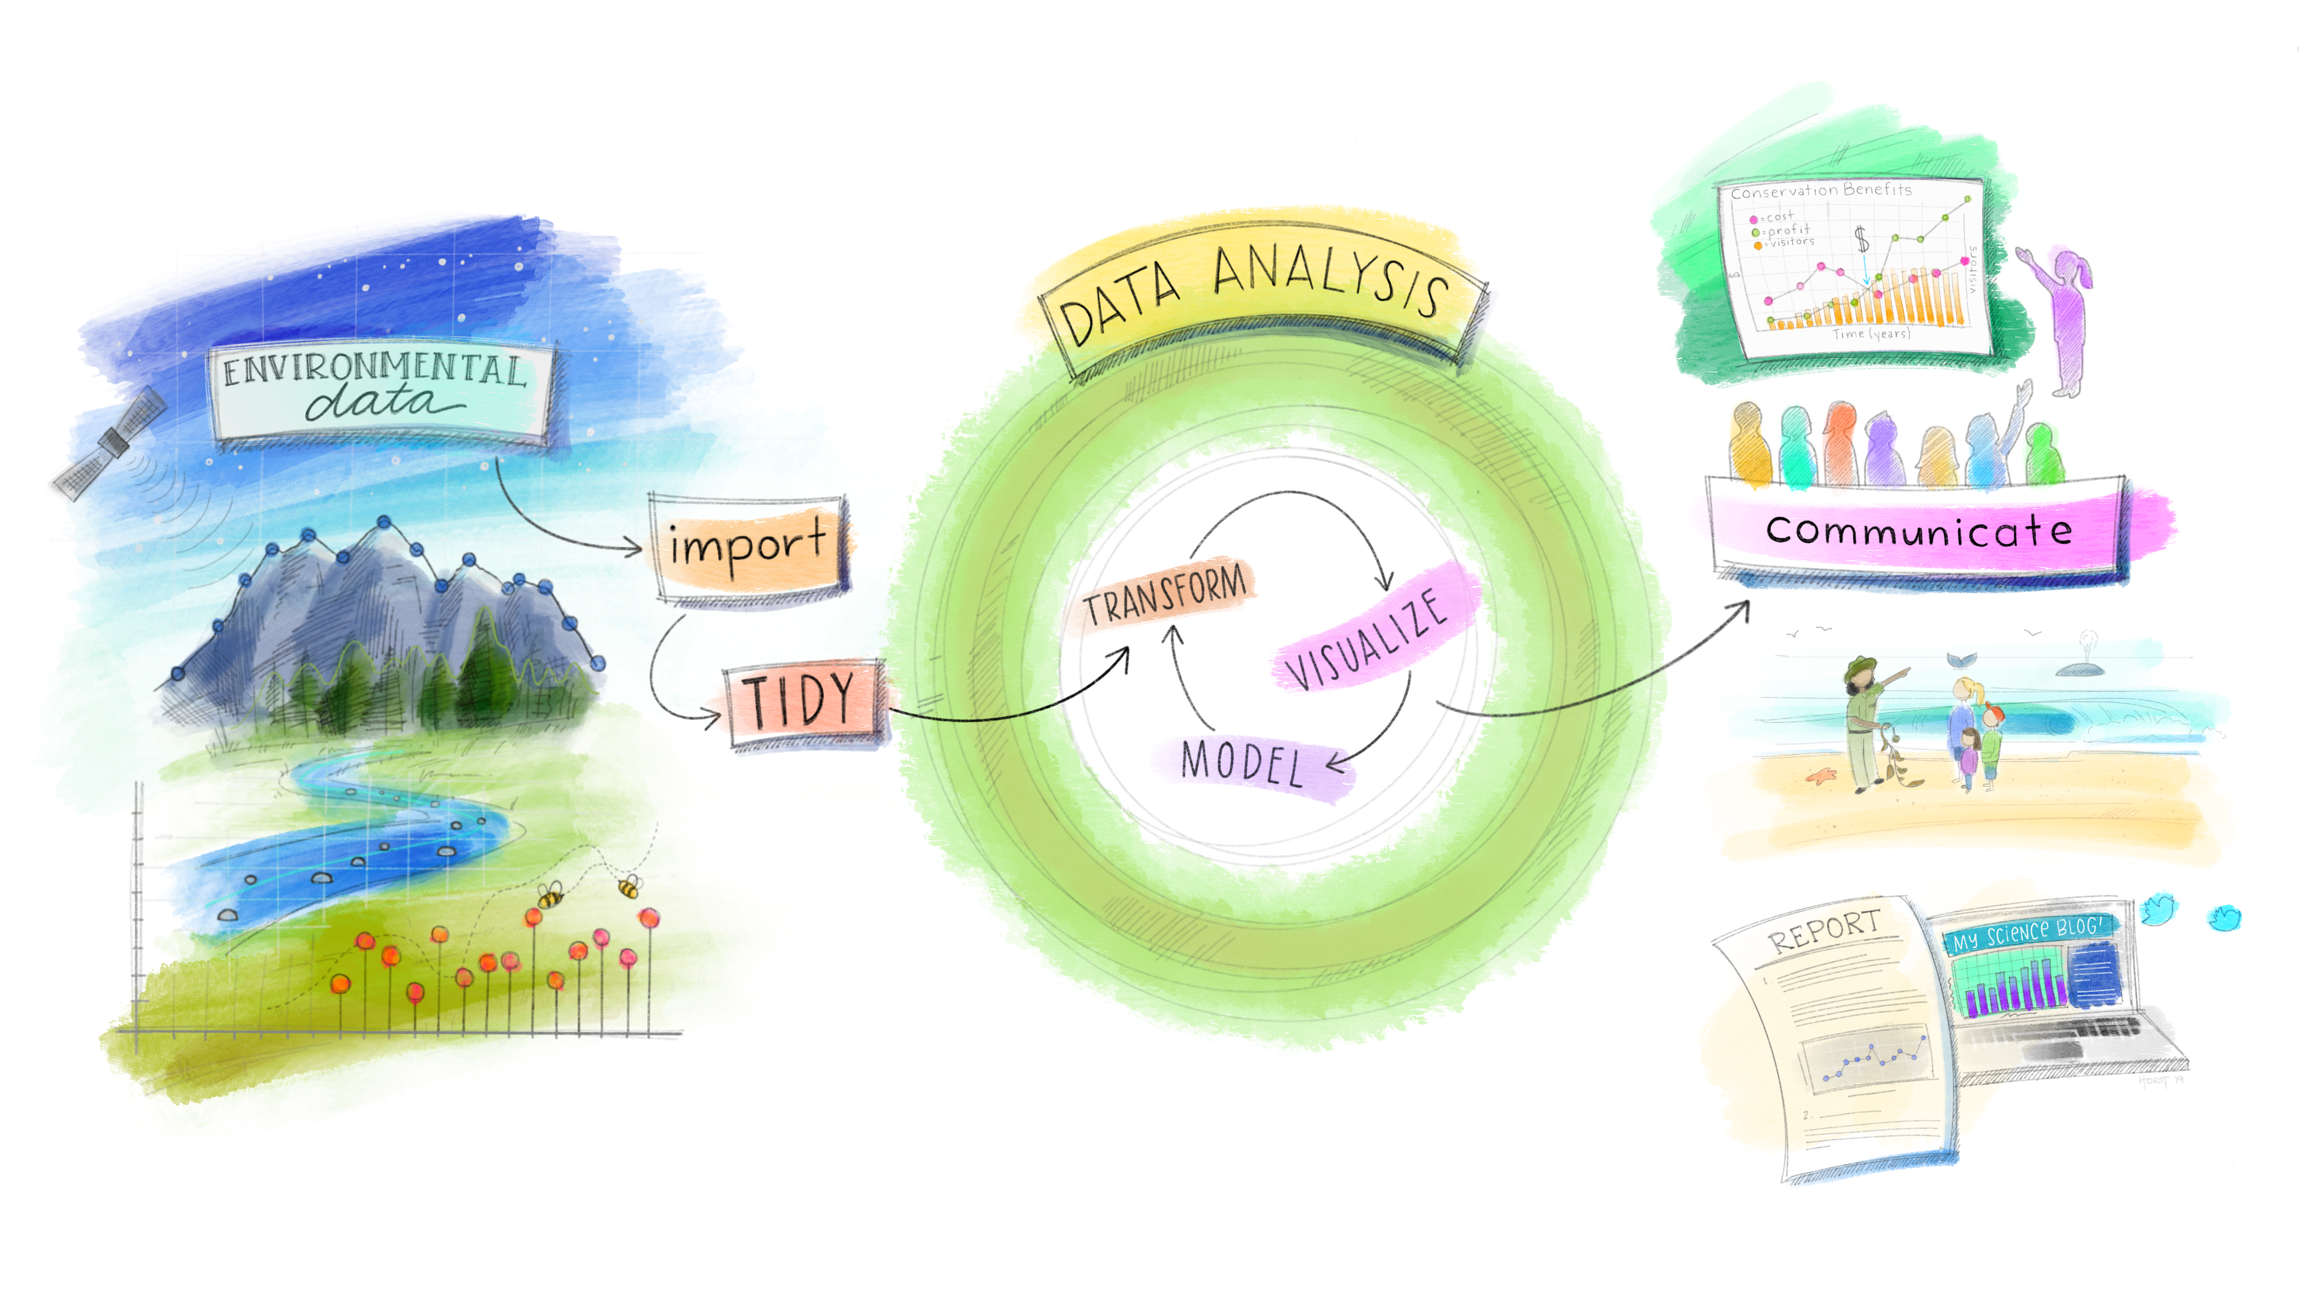
What will I learn in this course?
Practical / transferable skills – how to program in R and use QGIS software. Image from Julia Lowndes adapted from Grolemund and Wickham.

Slide 28
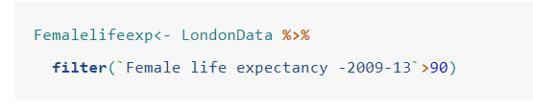
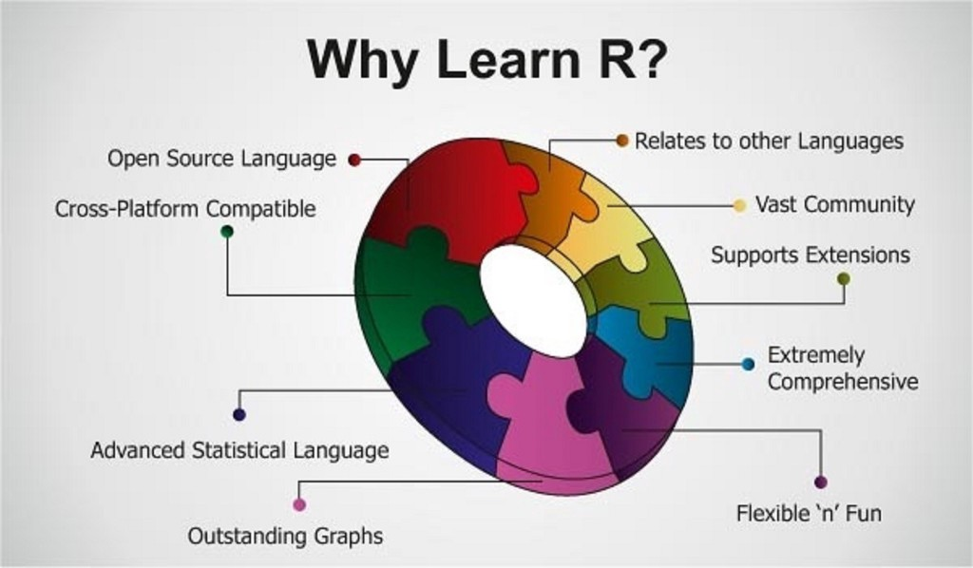
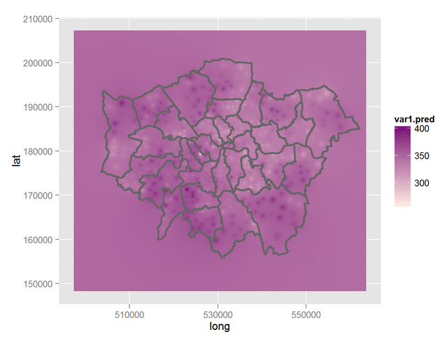
What will I learn in this course?
Practical / transferable skills – how to program in R and use QGIS software

Slide 29

What will I learn in this course?
Practical / transferable skills – how to program in R and use QGIS software
Doing analysis in R is hard. I still find it hard. It’s like learning a new language. You might know how to do it in ArcMap or Excel within seconds. People in this room will get to their dissertation and still filter data in excel. Nearly all of the distinctions for dissertations have some code.

Slide 30

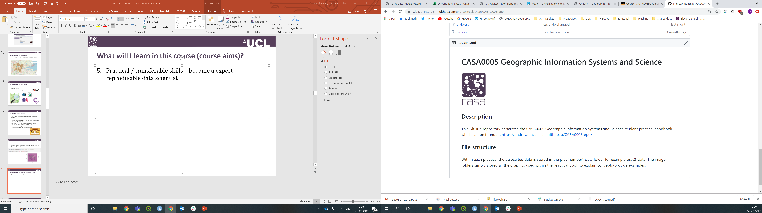
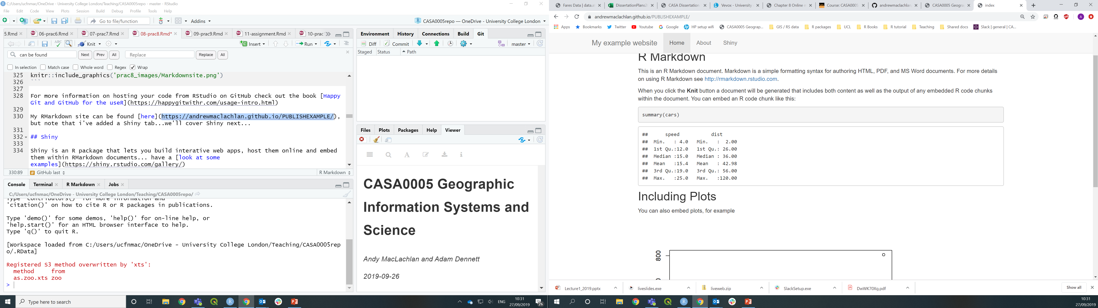
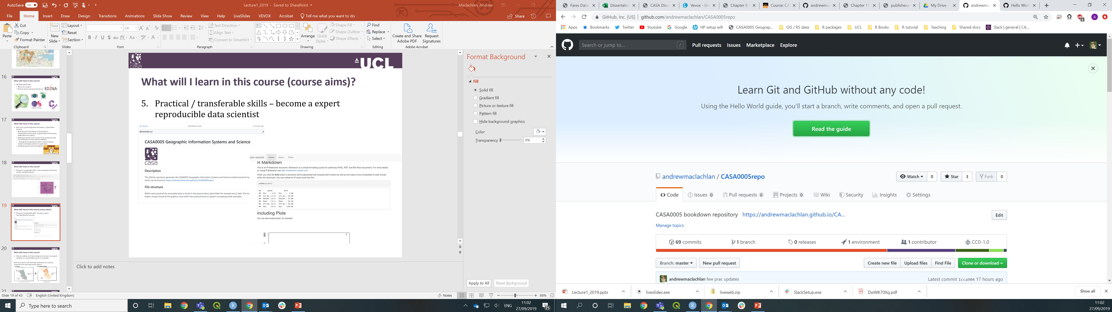
What will I learn in this course?
Practical / transferable skills – become a expert reproducible data scientist

Slide 31
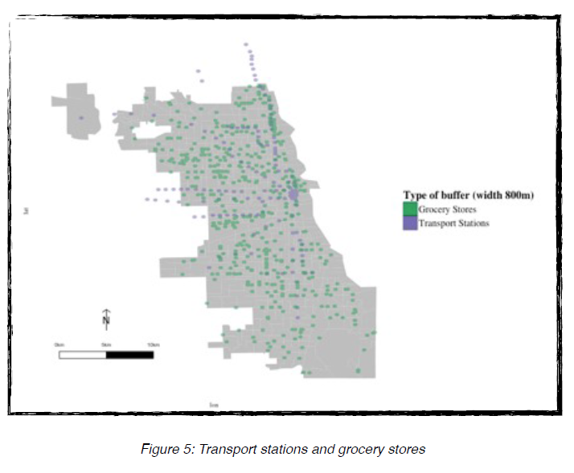
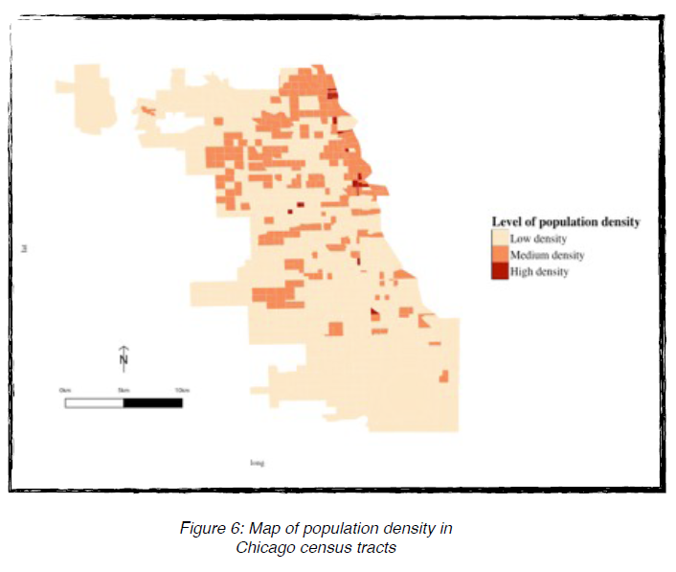
What will I learn in this course?
How to combine all of these things to solve your own spatial problem in a reproducible manner, for example…
How do we know if the dwelling construction in a city has occurred in the most appropriate places?
Amenities
Population Density
+

Slide 32
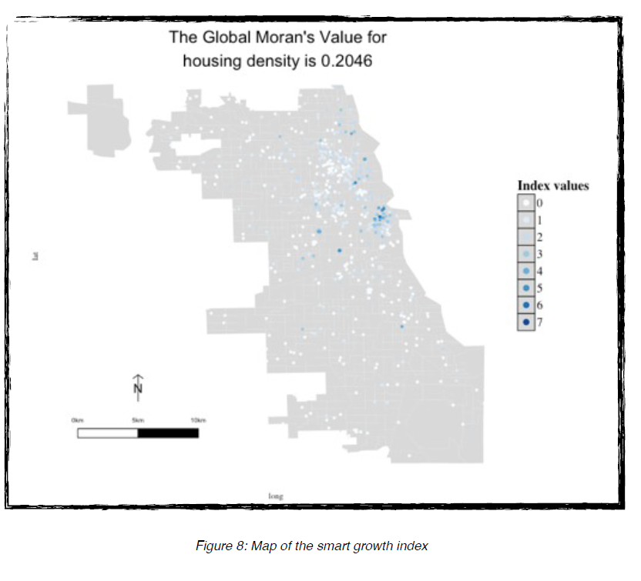
What will I learn in this course?
+ location of dwellings
=
Images: Philippe Vaillant, 2015

Slide 33
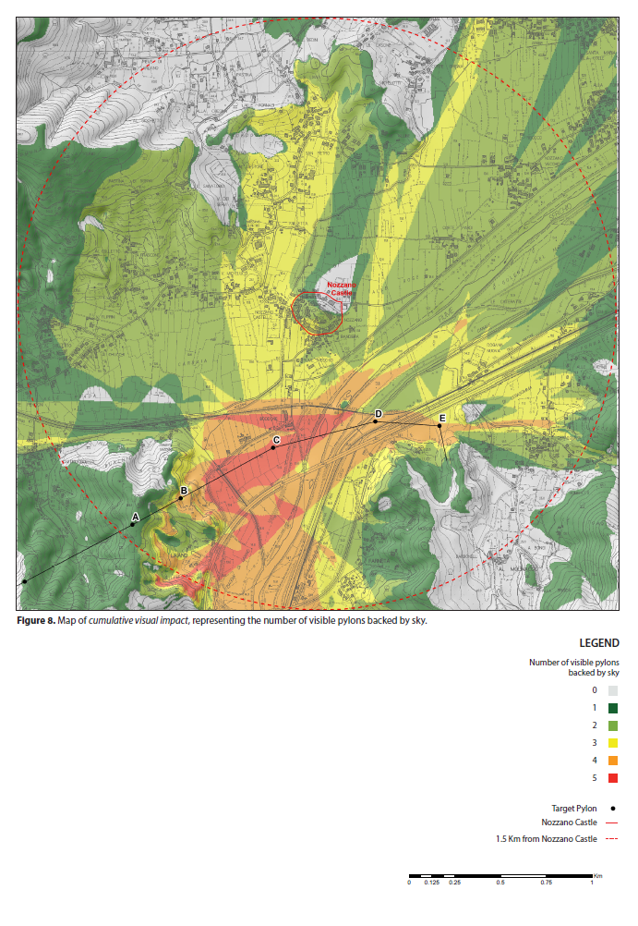



What could I achieve on this course?

Slide 34
What won’t I learn on this course…?
GIS is a huge field and so we can’t possibly cover everything in 10 weeks.
Adam’s research interests are in population geography (and beer geography!), so many of the examples will be related to spatial demographics (using Census data) and we be will be UK (especially London).
Andy’s interests are in GIS / remote sensing applications for sustainable city development.

Slide 35
Course content:
The course is divided into two ‘main’ parts. Before reading week we show you have to get started with all the software are tools you’ll need. Part 1 GIS tools.
The second part changes to more advanced analysis – the type you might consider exploring further for your assessment. Part 2 GIS analysis.
Full course outline is available over on Moodle along with the intended learning outcomes for the module
Each workshop also has associated learning outcomes.

Slide 36
Module learning outcomes (on Moodle):
Develop a working knowledge of QGIS and R to support the application of GI Science techniques
Visualise geographic information through producing appropriate maps to high cartographic standards
Carry out spatial data management tasks (joining attribute to geometry data, cleaning data, converting between file formats and spatial reference systems)
Interpret data and apply relevant spatial analyses (e.g. auto correlation/hot spot analysis, areal interpolation, point in polygon/buffer analysis) to answer a variety of spatial problems
Explain and evaluate common issues with geographic data such as representation and uncertainty
Apply and critique (spatial) statistical analysis techniques to infer relationships between spatial phenomena
Experience the diversity of the global spatial data landscape and evaluate the relative drawbacks and merits of different spatial datasets

Slide 37
Preparing for the assessment
This year the assessment is an open book exam:
Don’t just mindlessly do the practical each week
The weekly tasks are there to test you understand what you’ve done
Do the weekly homework tasks
They will be discussed / attempted by staff in the drop in sessions
The exam will be much easier as you’ll have a bank of code to use / know what to do.
If you don’t study prepare to fail. You can’t study the whole module within a week or two.

Slide 38

General Advice for the Course
Be patient!!
Things will crash
You will get lost/stuck and need to start again
R will send you crazy at times - R code is guaranteed to sometimes work on one computer but not on another running a different version/operating system – this is all part of the research process!
I will be assessing your ability to solve problems / answer questions using spatial data and the application of appropriate GIS tools – so don’t worry if you can’t write R code as well as some of your colleagues, you’ll still be able to achieve a good grade for the course
Put in the appropriate number of hours and you will be fine
Relax - we have plenty of time!

Slide 39
Right, now for the lecture…*
* Mercifully it’s quite short today thanks to me waffling on so long at the beginning!

Slide 40
Learning objectives and GIS basics
Describe and explain GIS data formats and databases
Source and pre-process spatial data
Load and undertaken some basic manipulation of spatial data in QGIS and R
Evaluate the (dis)advantages of each GIS you have used
A few terms:
Geographic / geographical: the Earth's surface and near-surface
Spatial: any space, (not just the space of the Earth's surface)
Spatial Analysis: application of techniques (in GIS) to geographic and non-geographic spaces
Geospatial: subset of spatial applied specifically to the Earth's surface and near-surface

Slide 41

What have you previously studied
Join: vevox.app ID: 186-395-009
POLL OPEN
Vote for up to 2 choices
1.
1.
Computer science
Computer science
0
5
2.
2.
Architecture
Architecture
3
1
3.
3.
Physical geography
Physical geography
0
3
4.
4.
Human geography
Human geography
5
1
5.
5.
Cartography
Cartography
0
1
6.
6.
Planning
Planning
0
8
7.
7.
Statistics
Statistics
0
1
8.
8.
Engineering
Engineering
0
3
9.
9.
Natural sciences
Natural sciences
0
2
10.
10.
Creative arts
Creative arts
0
0
11.
11.
Other
Other
10
0
6
Vote Trigger

Slide 42
Have you used a GIS before
Join: vevox.app ID: 186-395-009
POLL OPEN
Vote for up to 6 choices
1.
1.
R
R
0
0
2.
2.
QGIS
QGIS
0
0
3.
3.
ArcMap
ArcMap
0
0
4.
4.
Python
Python
0
0
5.
5.
Other
Other
0
0
6.
6.
I'm new
I'm new
0
0
10
Vote Trigger

Slide 43
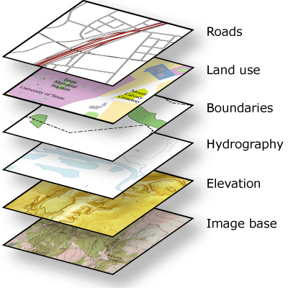





What is GIS?
Geographic Information Systems?
Or
Geographic Information Science?
Or
Spatial Data Science?
Well all of the above really…
…all data is collected
somewhere
Notes:
GI Systems – what and where
GI Science – how, that then informs GI systems
Geographic Information Systems help us to manage “what we know about the world”…
organize and store
access and retrieve
manipulate and synthesize
At their very base they contain Data which are raw geographic facts
e.g. a temperature at a given location on the earth’s surface

Slide 44
What is a GIS?
“Everyone does need to learn to code. It is no longer sufficient for a GI Scientists to just work with a standard GIS interface: menus, buttons and black boxes. ” Brunsdon and Comber (2020)
Previous work
Comparison of 4 GWR approaches all produced the same result except the method in ArcGIS from ESRI who didn’t reveal the code.

Slide 45


Slide 46
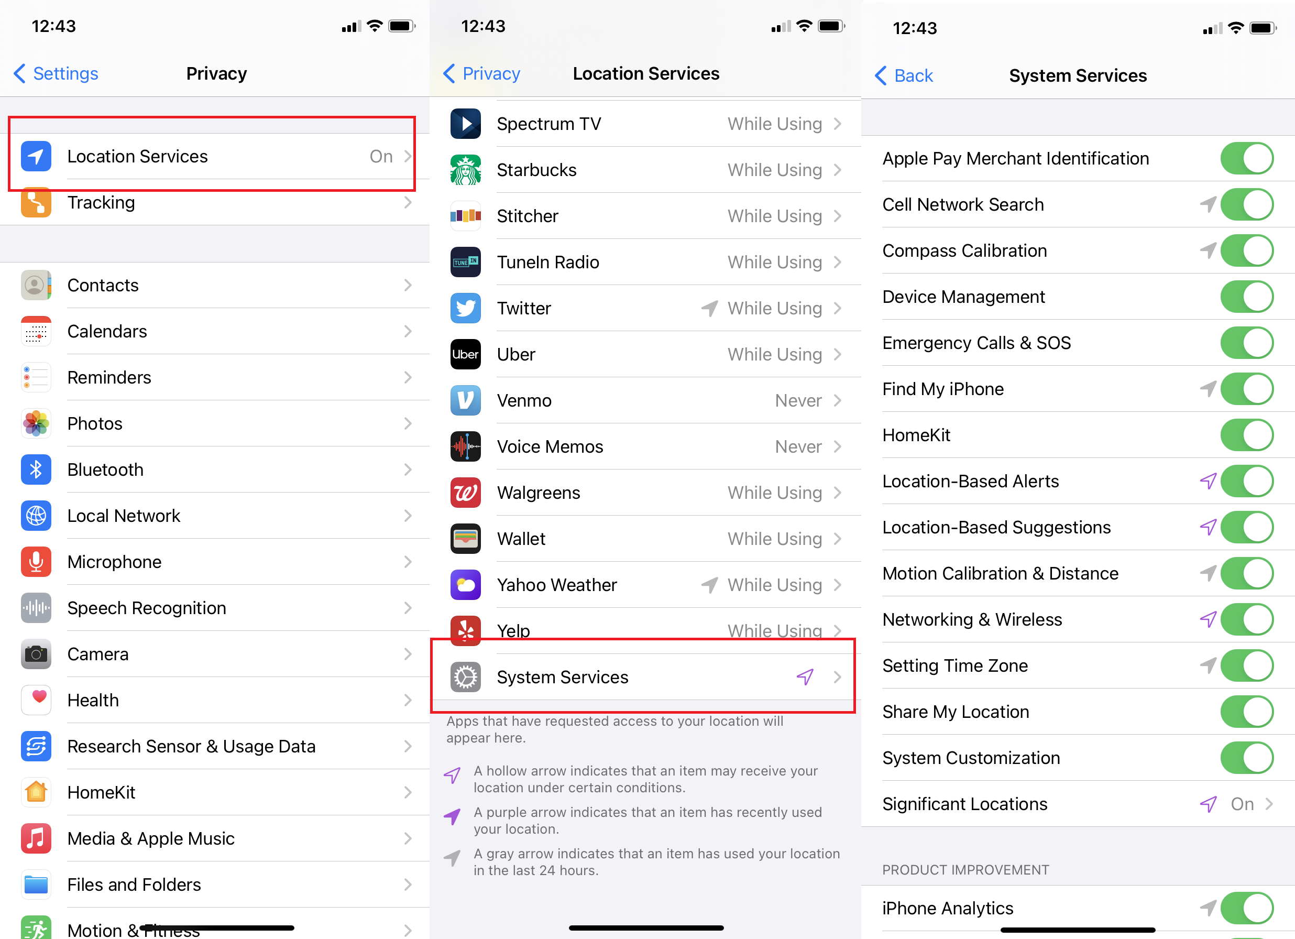

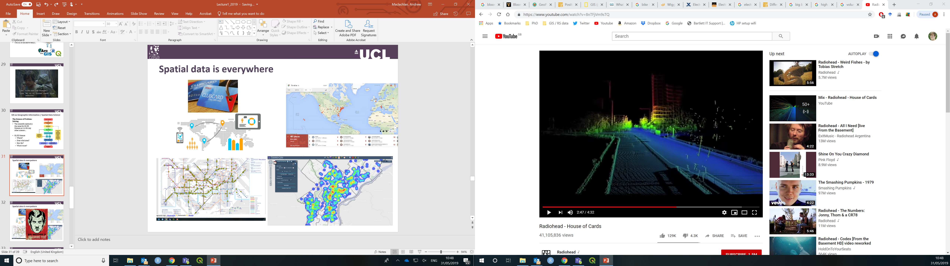
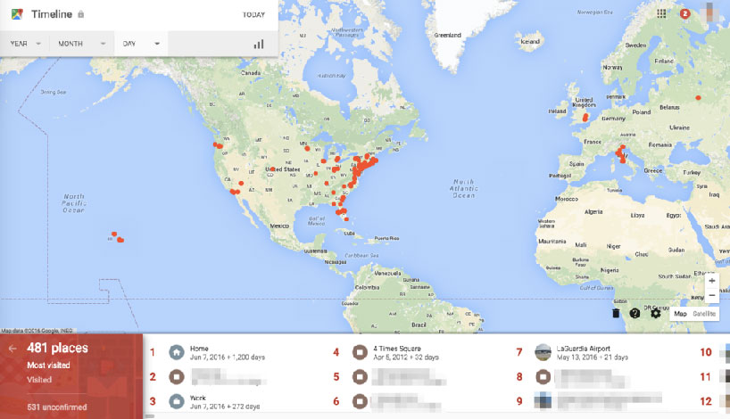

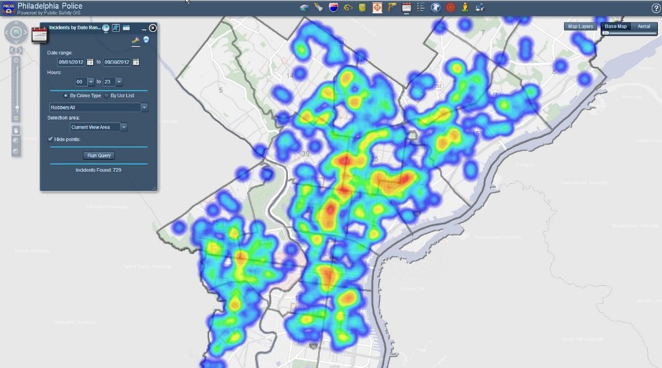
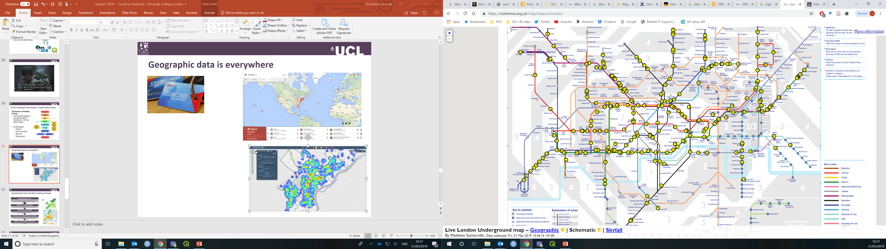
Spatial data is everywhere

Slide 47

Spatial data is everywhere

Slide 48
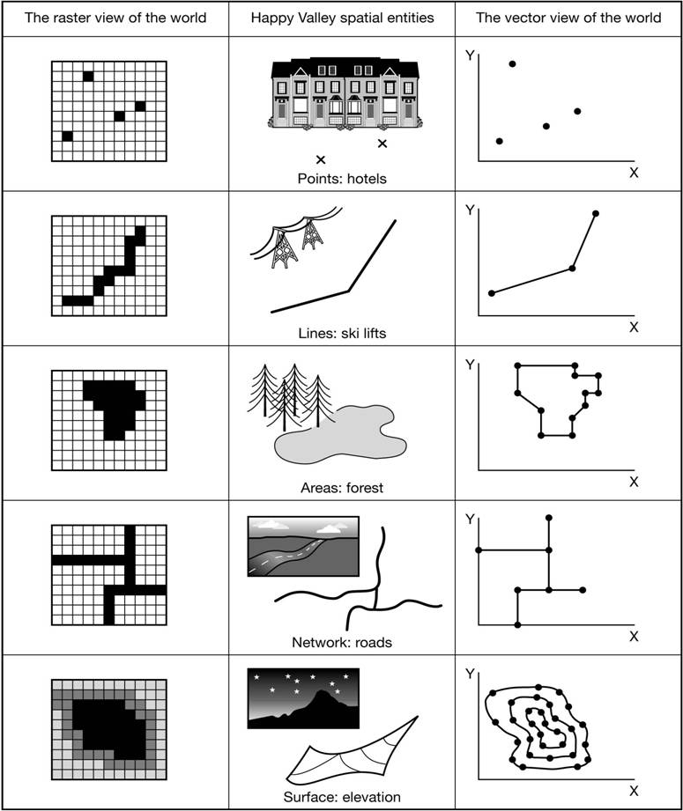
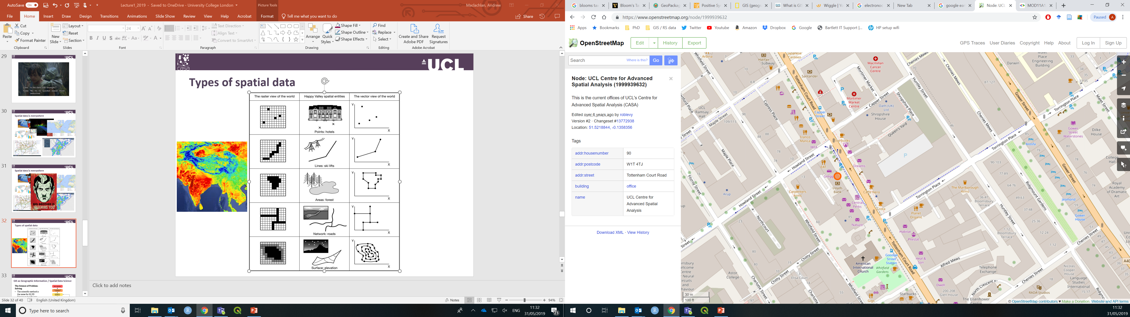
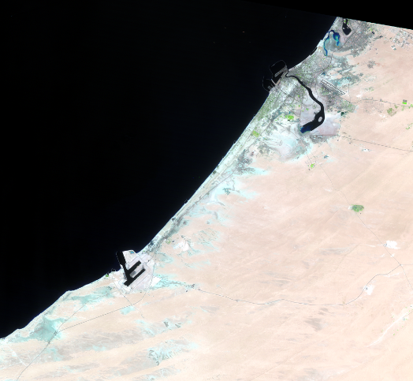
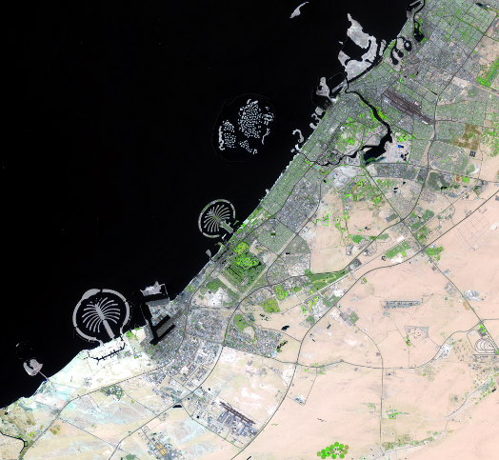
Types of spatial data: raster (‘grid’) Vs vector
Dubai 1984
Dubai 2017

Slide 49
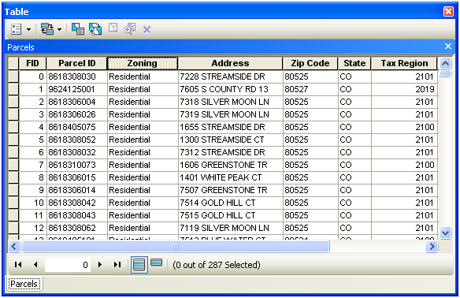
Features – vector data
Data type | Range | Size (mb) | Application
Long integer | -2,147,483,648 to 2,147,483,647 | 4 | Numeric values without fractional values within specific range
Float | -3.4E38 to 1.2E38 | 4 | Numeric values with fractional values within specific range
Text | Alphanumeric symbols | n/a | e.g. street names

Slide 50
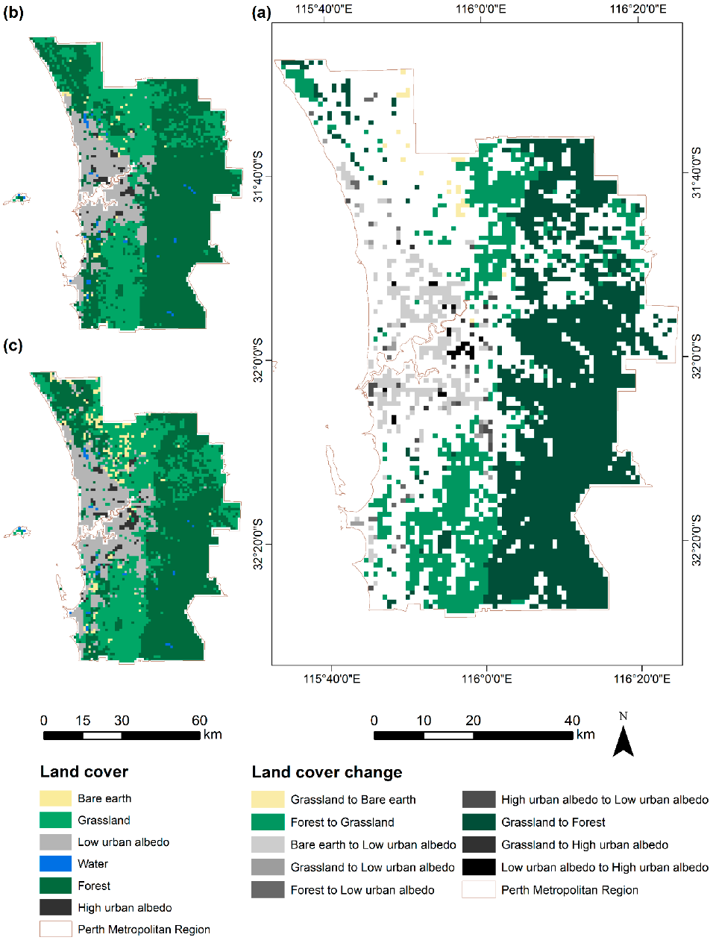
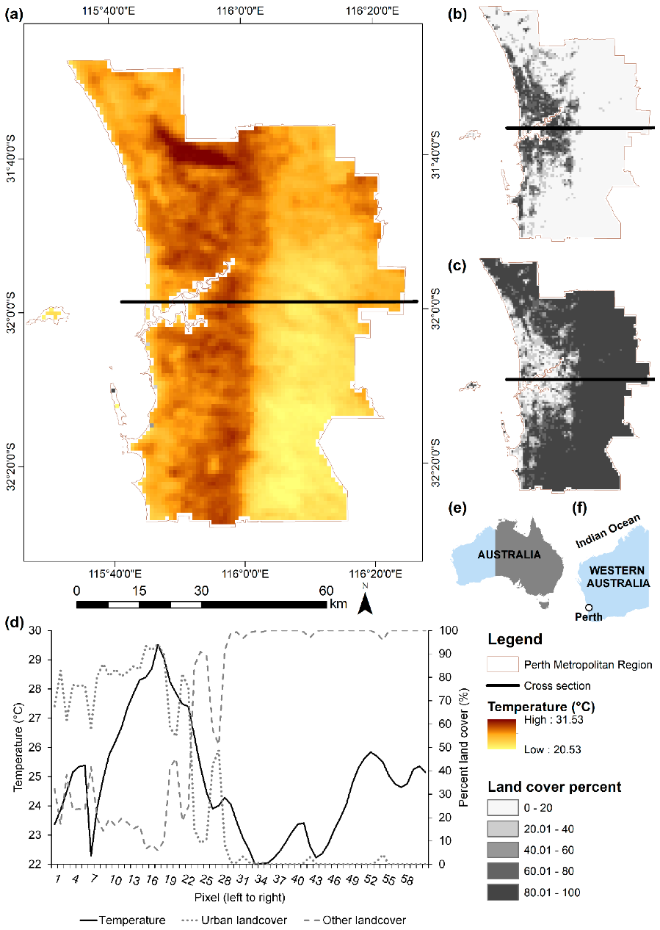
Features – raster data
Discrete (type: integer)
Continuous (type: floating point)
Notes:
Cell based
Continuous
Discrete
Sometimes raster data can have a scaling factor, or be a bit-encoded manner that refers to a code to extract the information. Read documentation and meta-data.

Slide 51
Formats
Type | Format | Range
Vector | Shapefile | ESRI’s standard format. Mostly open. Creates multiple files for a single layer. (e.g. .shp, .shx)
 | GeoJSON | Standard open data interchange format. Based on JavaScript Object Notation. Maintained by internet working group.
Both | Geopackage | Database of vector and raster layers held in a single file.
Both | Geodatabase | ESRI’s format for storing multiple raster and vector layers.
Raster | GeoTIFF | Geostationary Earth Orbit Tagged Image File. Standard, public domain format. Geospatial tags in image.
 | BSQ | Band SeQuential – binary. Each band is one file with header file bringing together. Can just read in what you want.
 | HDF | Hierarchical Data Format – NASA. Large scientific datasets.
 | Arc Grid | ESRI’s standard for raster

Slide 52
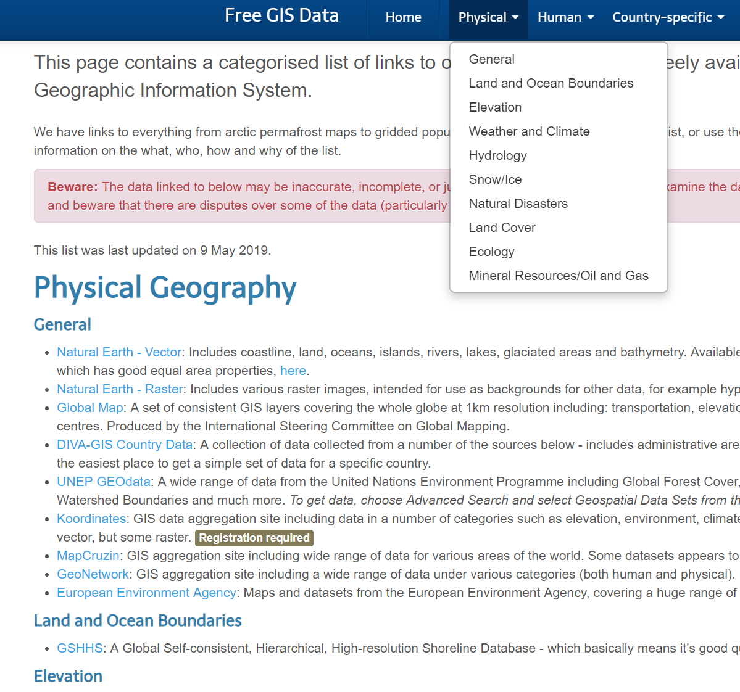
Sources
Raster
USGS Earth Explorer
Environment Agency LiDAR
Geoscience Australia LiDAR
Vector
GADM – global country outlines
Open Street Map
OS Master Map
Both
Free GIS lists (e.g. RT Wilson)
Volunteered Geographic Information (VGI)

Slide 53

Sources
Raster
USGS Earth Explorer
Environment Agency LiDAR
Geoscience Australia LiDAR
Vector
GADM – global country outlines
Open Street Map
OS Master Map
Both
Free GIS lists (e.g. RT Wilson)
Volunteered Geographic Information (VGI)
Always read the metadata.

Slide 54
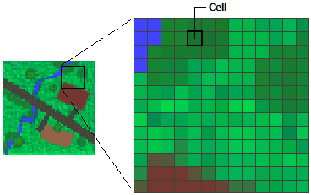
Summary
Spatial data has a type
These come in a range of formats (file types)
The attribute of the spatial data will also have a type
Which spatial data type could more easily have multiple attribute types ?

Slide 55
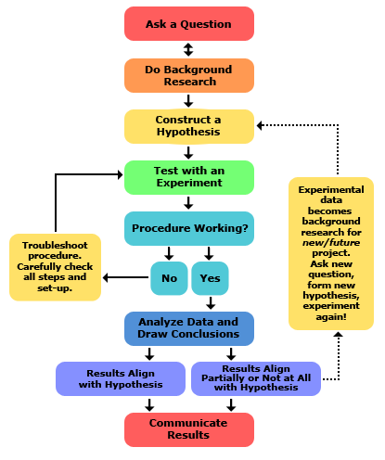
GIS as Geographic Information / Spatial Data Science
The Science of Problem-Solving
The scientific method is the same for GI/SD Science as it is for any other science…->
GI/SD Science…the science of where
Where?
Over what area?
How far?
Which route?
What’s the spatial relationship to each other

Slide 56
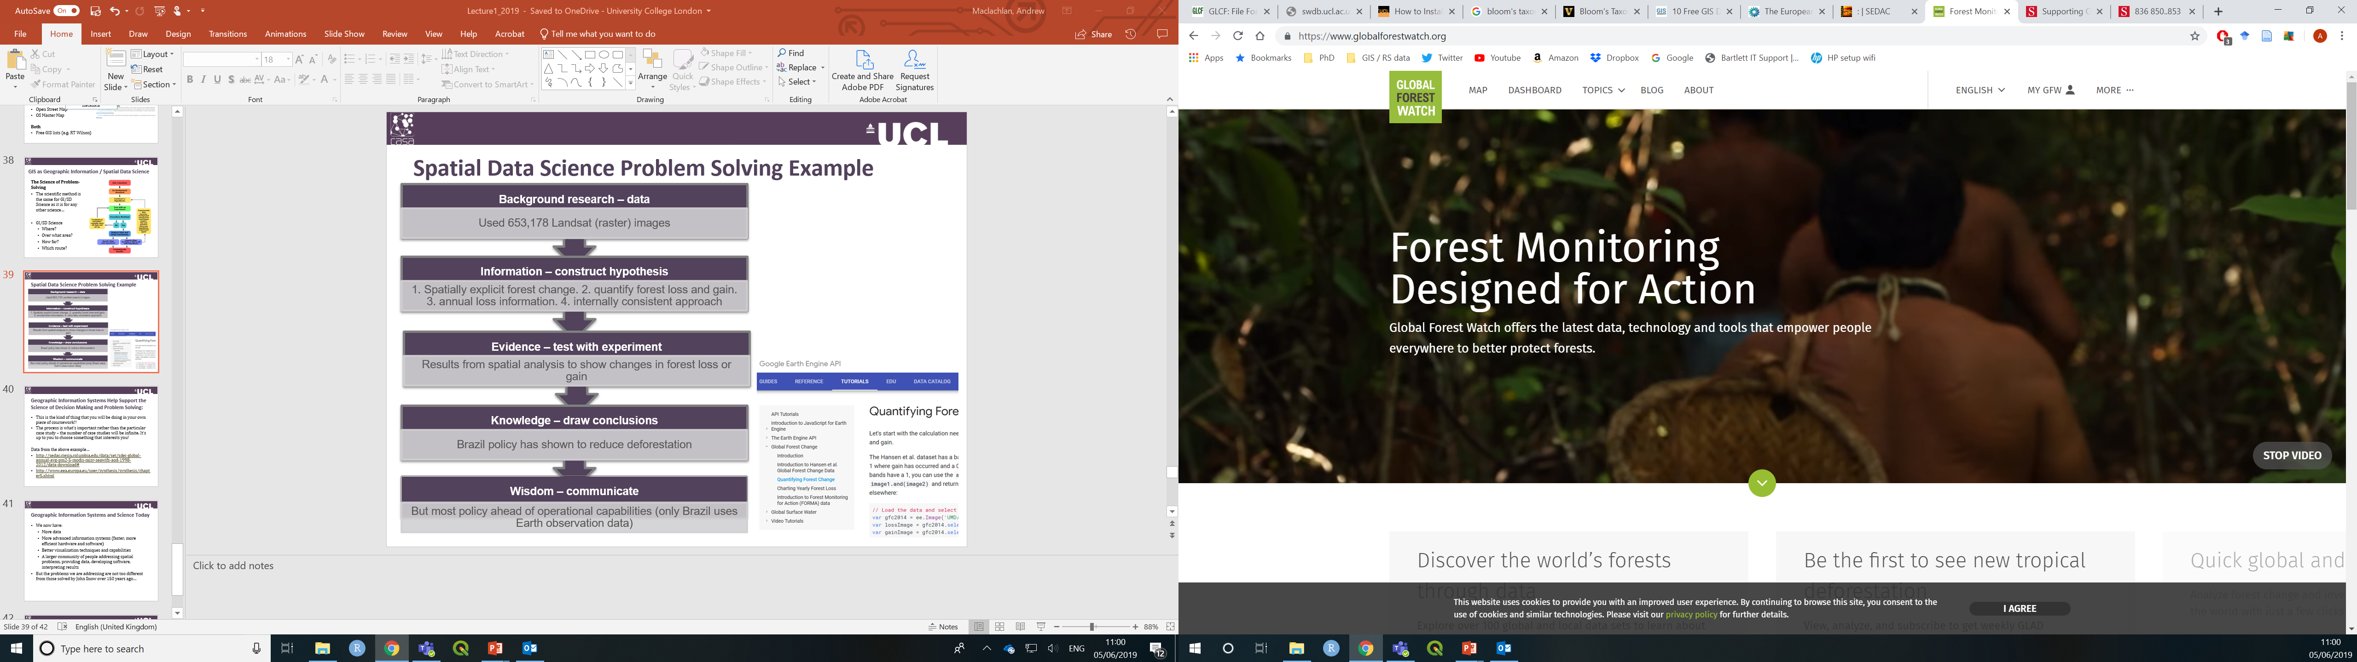
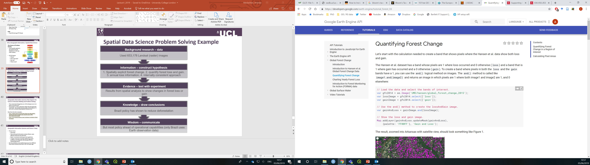
Spatial Data Science Problem Solving Example
Background research – data
Hansen et al. 2013
High-resolution global maps of 21st century forest cover change. Used 653,178 Landsat (raster) images.
Information – construct hypothesis
1. Spatially explicit forest change. 2. quantify forest loss and gain. 3. annual loss information. 4. internally consistent approach.
Evidence – test with experiment
Results from spatial analysis to show changes in forest loss or gain.
Knowledge – draw conclusions
Brazil policy has been shown to reduce deforestation.
Wisdom – communicate
But most policy ahead of operational capabilities (only Brazil uses Earth observation data). Could use this free method or similar.
Notes:
Data and code walk through in Google Earth Engine.
This is the kind of thing that you will be doing in your own piece of coursework!!
The process is what’s important rather than the particular case study – the number of case studies will be infinite. It’s up to you to choose something that interests you!

Slide 57
Geographic Information Systems and Science Today
We now have:
More data (big data)
More advanced information systems (faster, more efficient hardware and software)
Better visualisation techniques and capabilities
A larger community of people addressing spatial problems, providing data, developing software, interpreting results

Slide 58
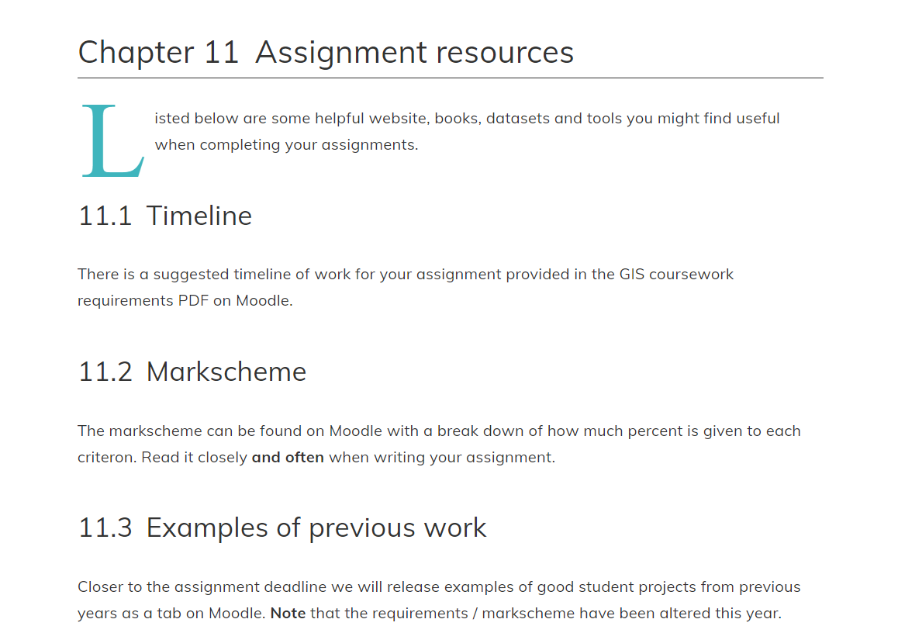
Workshop this week - Geographic Information
Head over to the online practical book – just work from here and follow the instructions. Each chapter = 1 workshop.
Install the software you need – QGIS and R
There are plenty of resources linked to from within the book
You have 23 hours now to make a start on the workshop – come along to your session armed with plenty of questions.
There is rolling weekly feedback at the end of each workshop

